Slide 1
Dashboard Analysis & Recommendations

Slide 2
1) Tap into higher-growth foreign markets by delivering content suited and tailored to those regions.
Noting that 3,210 of the 8,801 titles (Approx. 36.5%) are targeted towards the American audience (see Map visualization – “Number of Netflix Titles by Country” in dashboard file), Netflix may think to consider pushing for more diverse content that appeals to local tastes in different countries worldwide. One way to achieve this could be through partnering with local/international superstar Actors/Actresses in various regions or with up-and-coming talent to direct and produce exclusive, Netflix-only content.
A 2020 article by ‘TheVerge.com’ claims U.S. growth in paid subscribers has slowed precipitously from 2018 as the company has already cornered and dominated that market, despite the emergence of recent competition from Disney Plus and Amazon Prime. An Analyst describes Netflix’s current and future U.S. growth prospects, “Nathanson adds that over the next five years, he expects Netflix to slow down to around 1 million US subscribers each year. It’s quite a departure from the 5 million average subscribers Netflix was adding in the US between 2012 and 2018, as seen in the chart on the next slide.” https://www.theverge.com/2020/2/20/21142065/netflix-streaming-wars-subscriber-growth-disney-international
There are other highly populous regions such as India, China, and the African continent, each containing more than a Billion people that Netflix has yet to completely embrace and compete for. Further, these regions are experiencing faster population and economic growth than the U.S., and these two trends are expected to continue in the next few years at the very least. Netflix has the opportunity here to take advantage of these two, rare phenomena and propel itself to new heights and further success.

Slide 3
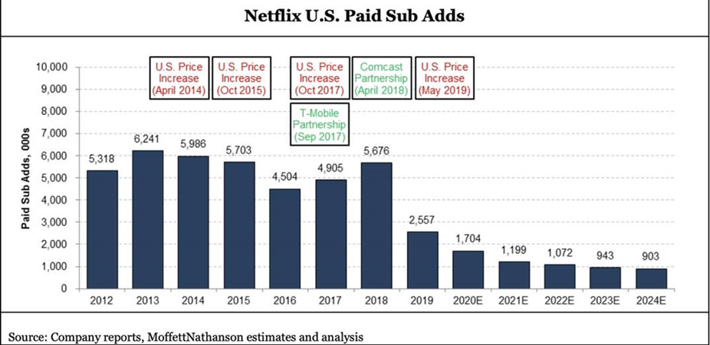
1) Tap into higher-growth foreign markets by delivering content suited and tailored to those regions.

Slide 4
2) Increase periodic visits through more TV Show options.
The second suggestion I’d make in order to entice users to come back and spend more time interacting with Netflix content is to provide more ‘TV show’ options as this will usually get subscribers to return more often.
This strategy would alter the current status quo, which is heavily tilted towards Movies (nearly 70% of all Titles are classified as ‘Movie’).
One way to achieve this is by signing with local talent in various regions globally and tapping into markets that are not adequately adhering to local streaming tastes/desires by competitor platforms to develop and produce TV shows that may become popular and draw more subscribers.

